Slide 1
Image Filtering Using Convolution in OpenCV
https://learnopencv.com/image-filtering-using-convolution-in-opencv/#intro-convo-kernels
https://docs.opencv.org/4.5.4/d4/d13/tutorial_py_filtering.html

Slide 2
An Introduction to Convolution Kernels in Image Processing
In image processing, a convolution kernel is a 2D matrix that is used to filter images. Also known as a convolution matrix, a convolution kernel is typically a square, MxN matrix, where both M and N are odd integers (e.g. 3×3, 5×5, 7×7 etc.). See the 3×3 example of the averaging filter matrix given below.
The operation works like this:
keep this kernel above a pixel, add all the 9 pixels below this kernel, take the average, and replace the central pixel with the new average value. This operation is continued for all the pixels in the image.

Slide 3
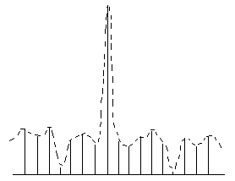

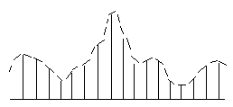
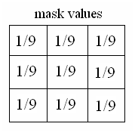
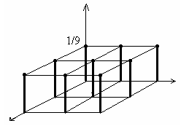
Function + Window = Filter
Image Smoothing
Linear Smoothing Filters
1-D case:
Input data
Mean filter
Smoothed data
2-D case:

Slide 4
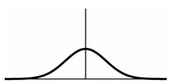
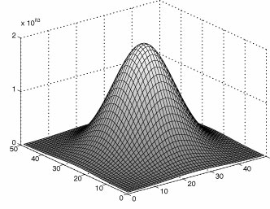
Gaussian Smoothing
1D:
2D:
Discrete case:

Slide 5
Why would you want to blur an image?
Because it reduces certain types of noise in an image. For this reason, blurring is often referred to as smoothing.
To remove a distracting background, you might intentionally blur portions of an image, as is done in ‘Portrait’ mode, on mobile device cameras.

Slide 6
How to use this kernel with OpenCV filtering function cv2.filter2D().
Read the test image
Define the kernel, using a N×N NumPy array , where N must be an odd number.
Use the cv2.filter2D() function in OpenCV to perform the linear filtering operation.
Display the original and filtered images, using cv2.imshow() function.
Save the filtered image to disk, using cv2.imwrite() function.

Slide 7
filter2D.py
import numpy as np
import cv2 as cv
from matplotlib import pyplot as plt
# In command line, type 'pip install matplotlib' to install matplotlib before running this program.
img = cv.imread('lena_noise.jpg')
# Read the test image 'lena_noise.jpg‘.
# kernel = np.ones((5, 5), np.float32)/25
kernel = np.ones((3, 3), np.float32)/9
# Define the kernel, using a N×N NumPy array, where N is odd.
dst = cv.filter2D(img, -1, kernel)
# Use the cv2.filter2D() function in OpenCV to perform the linear filtering operation.
cv.imshow("Original", img)
cv.imshow("Averaging", dst)
# Display the original and filtered images, using cv2.imshow() function.
cv.imwrite('lena_noise_average.jpg', dst)
# Save the filtered image to disk, using cv2.imwrite() function.
plt.subplot(121), plt.imshow(img), plt.title('Original')
plt.xticks([]), plt.yticks([])
plt.subplot(122), plt.imshow(dst), plt.title('Averaging')
plt.xticks([]), plt.yticks([])
plt.show()

Slide 8
cv2.filter2D(src, ddepth, kernel)
OpenCV provides a function cv.filter2D() to convolve a kernel with an image.
The first argument scr is the source image.
The second argument is ddepth, which indicates the depth (bits) of the resulting image. A value of -1 indicates that the final image will also have the same depth as the source image.
The final input argument is the kernel, which we apply to the source image.

Slide 9
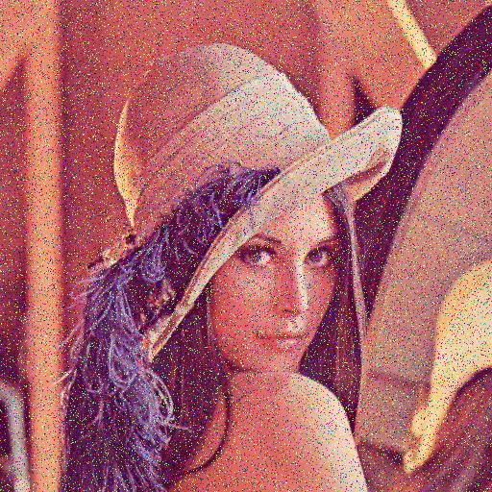

Original image with noise
Processed with Averaging Kernel

Slide 10
。Roberts operator:
。Prewitt filters
。Sobel operator:
。Robinson operator:
。Kirsch operator:

Slide 11
Roberts cross: https://en.wikipedia.org/wiki/Roberts_cross
Prewitt operator: https://en.wikipedia.org/wiki/Prewitt_operator
Sobel operator: https://en.wikipedia.org/wiki/Sobel_operator
Kirsch operator: https://en.wikipedia.org/wiki/Kirsch_operator

Slide 12
Let’s move to OpenCV document to explore more popular functions that can smooth images.
https://docs.opencv.org/4.5.4/d4/d13/tutorial_py_filtering.html
cv.filter2D() cv.blur() cv.getGaussianKernel() cv.medianBlur() cv.bilateralFilter()

